Slide 1
GICharm: A System Level Analysis Tool for Geomagnetic Disturbance Related Harmonics
Andres Ovalle, PhD
Engineer Scientist III
EPRI, Knoxville, TN
May 12th, 2022

Slide 2

Speaker
Andres Ovalle
Andres Ovalle is an Engineer/Scientist III with the Power System Studies team at the Electric Power Research Institute (EPRI). His current research activities focus on modeling of power systems, system protection in distribution and transmission, and impacts geomagnetic disturbance related harmonics on power systems. Mr. Ovalle joined EPRI in 2018. Prior to joining EPRI, Mr. Ovalle was with the French National Railways Company (SNCF) and the Grenoble Electrical Engineering Laboratory (G2E-lab) for approximately 2 years where he worked as a postdoctoral research engineer in the use of energy storage for the support of electrified railways. Mr. Ovalle received the B.S.E.E. degree from the Universidad de Los Andes, Bogota, Colombia, in 2011, the M.E.E. degree from the Universidad de Los Andes in 2013, and the Ph.D. in Electrical Engineering from the Université de Grenoble Alpes, Grenoble, France, in 2016.

Slide 3
Agenda
What is GIC and GIC related harmonics?
EPRI GICharm
Transformer level Analysis
System level Analysis
Test cases to explore
Quick demo

Slide 4
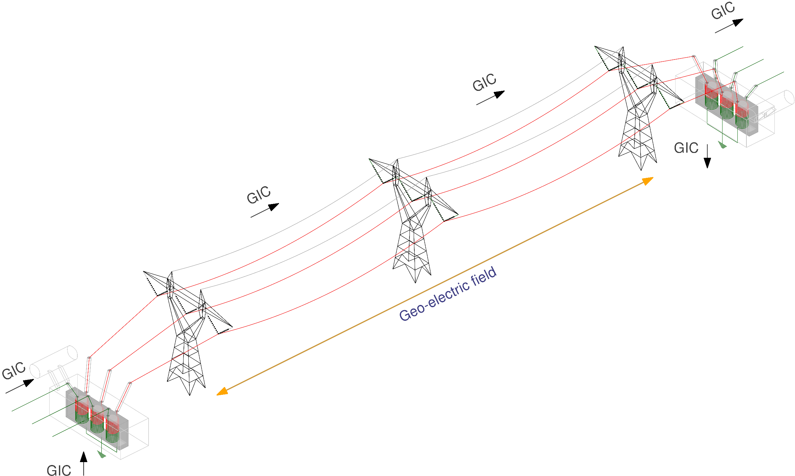
What is GIC?
Geomagnetic disturbance event
Quasi-DC currents induced on transmission lines (man-made long metallic infrastructures)
GIC flows can be computed using industry software
[1] EPRI, Geomagnetic disturbance vulnerability assessment and planning guide, 3002013590, 2018.
[2] NERC, GMD Monitoring, mitigation and next steps, literature review and summary of the April 2011 NERC GMD workshop, 2011.
[3] IEEE Guide for Establishing Power Transformer Capability while under Geomagnetic Disturbances," in IEEE Std C57.163-2015 , vol., no., pp.1-50, 26 Oct. 2015

Slide 5
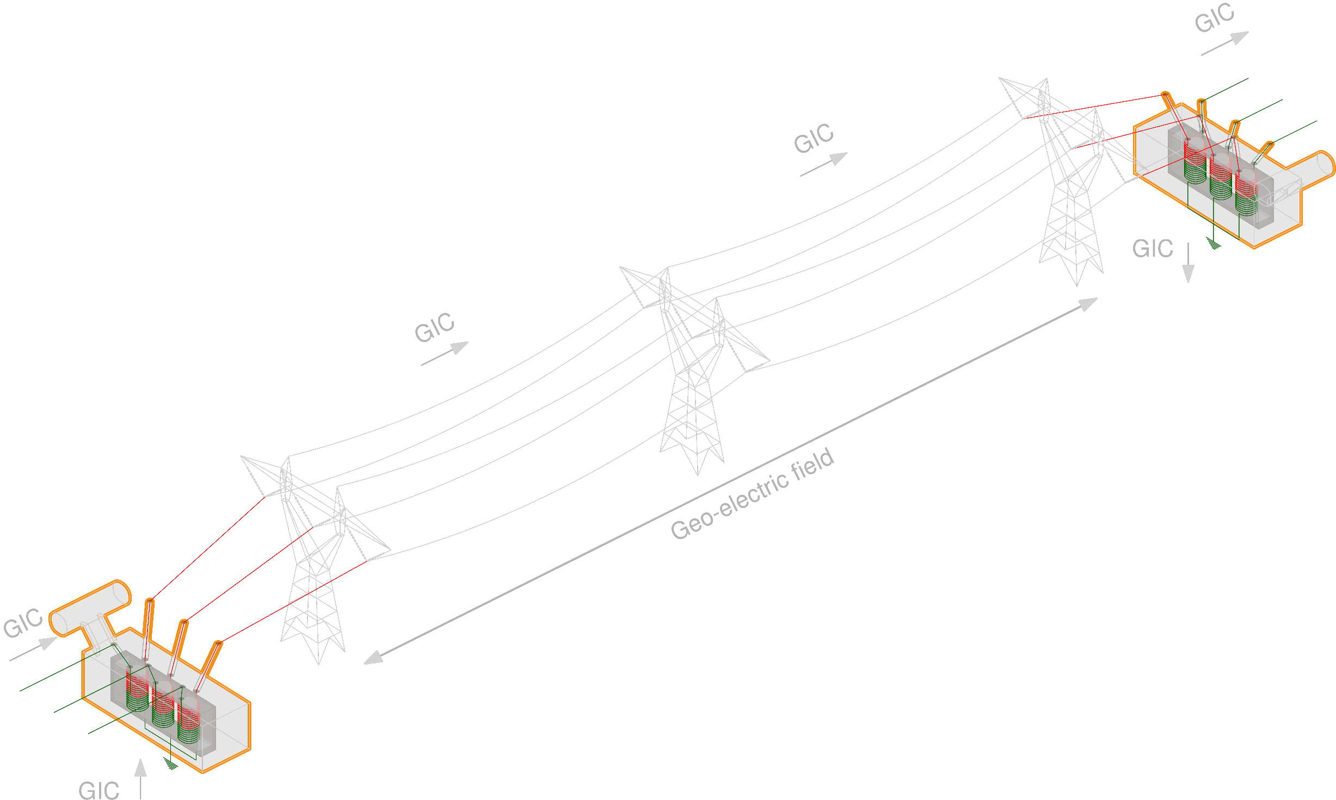
What is GIC?
Geomagnetic disturbance event
Quasi-DC currents induced on transmission lines (man-made long metallic infrastructures)
GIC flows can be computed using industry software
Transformer saturation
Saturation induced harmonics
Reactive Power loss
Impacts on protection equipment, resonance, etc.
[1] EPRI, Geomagnetic disturbance vulnerability assessment and planning guide, 3002013590, 2018.
[2] NERC, GMD Monitoring, mitigation and next steps, literature review and summary of the April 2011 NERC GMD workshop, 2011.
[3] IEEE Guide for Establishing Power Transformer Capability while under Geomagnetic Disturbances," in IEEE Std C57.163-2015 , vol., no., pp.1-50, 26 Oct. 2015

Slide 6
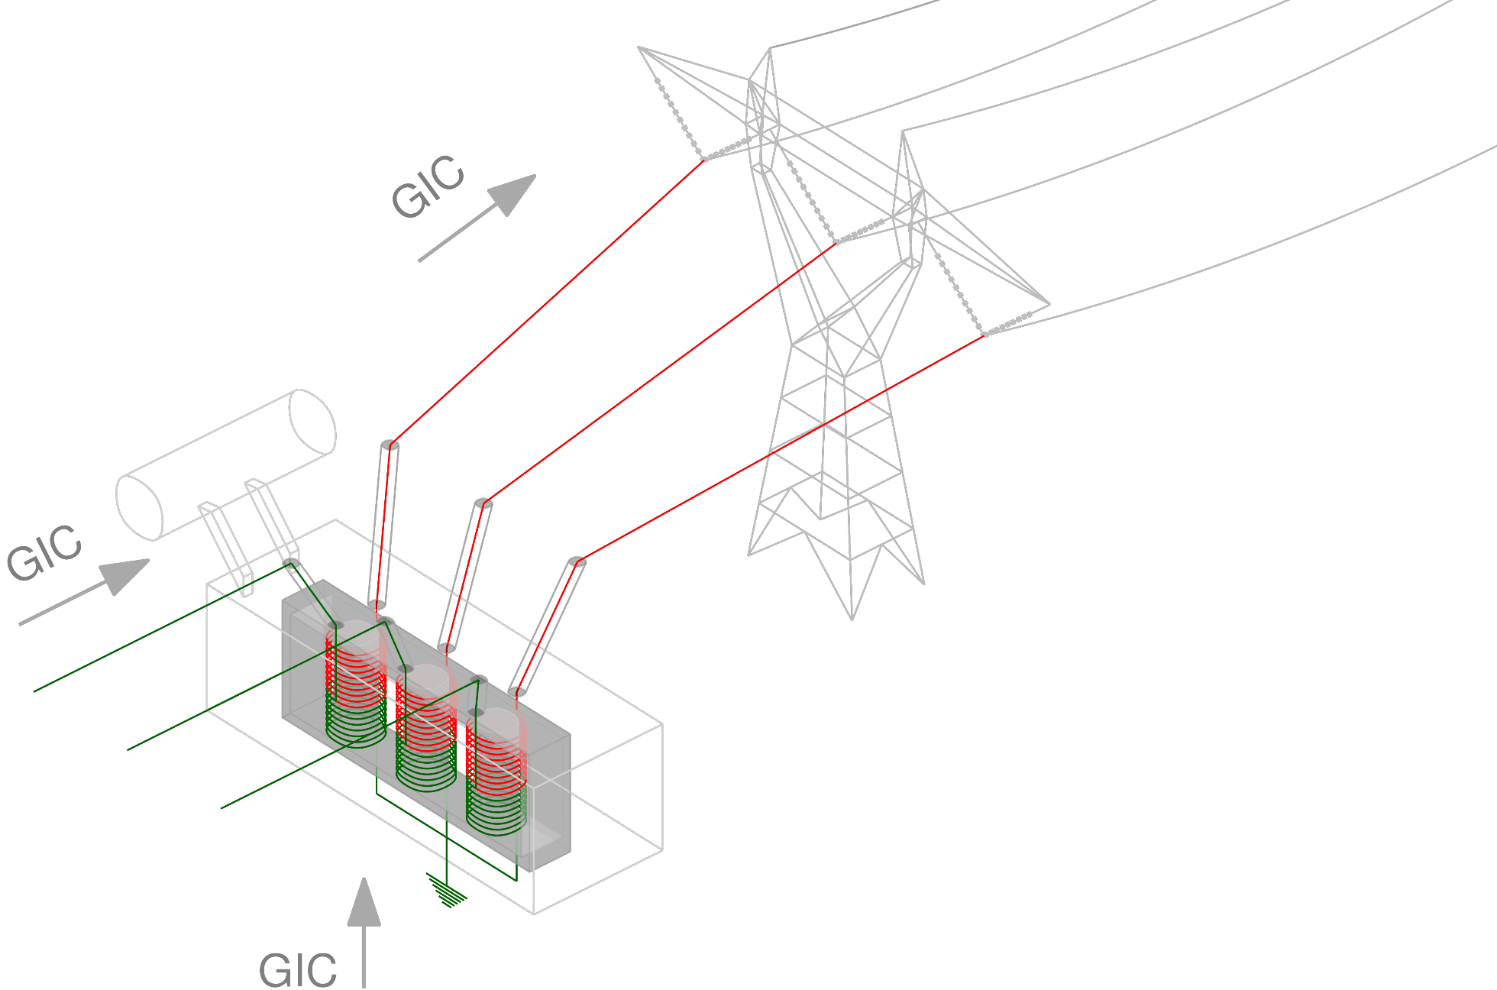
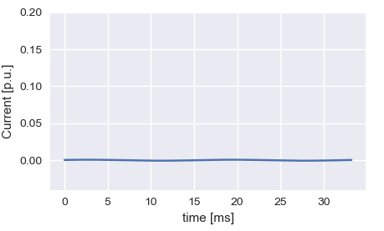
GIC Related Harmonics
Transformer core saturation
Excitation currents and reactive power losses
Excitation currents Normal operation

Slide 7
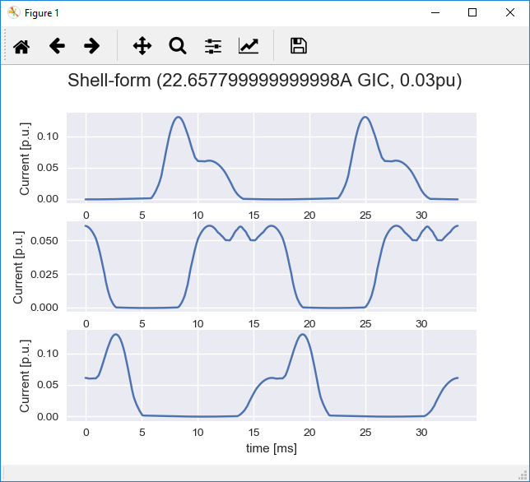
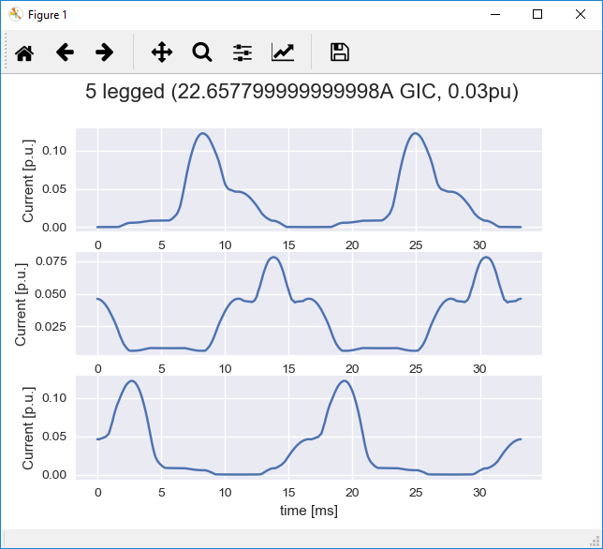
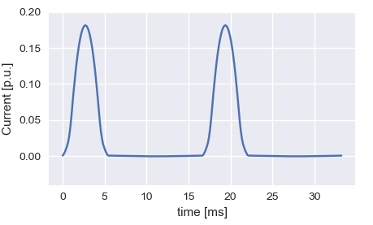
GIC Related Harmonics
Transformer core saturation
Excitation currents and reactive power losses
Excitation currents half-cycle saturation
Core-dependent

Slide 8
GIC Related Harmonics
Transformer saturation
Excitation currents and reactive power losses
Core topology dependence
How to handle hundreds of transformers in the bulk power system?
Lack of tools to assess the impact of GIC related harmonics in the bulk power system

Slide 9
EPRI GICharm

Slide 10

EPRI GICharm
Software tool to assess the impact of GIC related harmonics
Most recent version available to the public in through www.epri.com (link below)
Extensive system modeling
Accurate representation of transformer saturation
Uses EPRI’s OpenDSS engine
Includes built-in converter from a commercial planning software
https://www.epri.com/research/products/000000003002018769

Slide 11
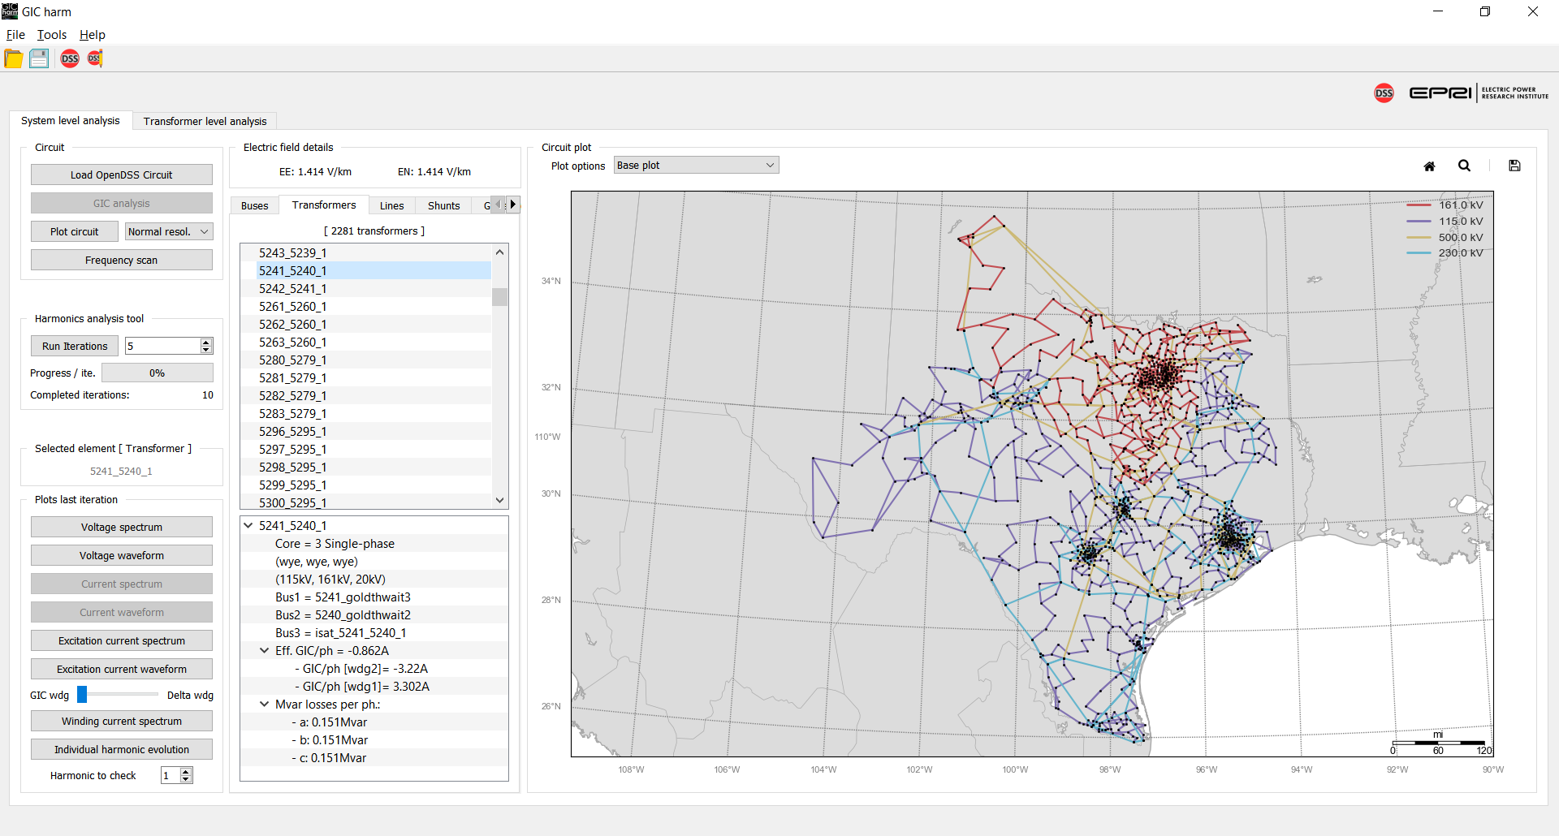
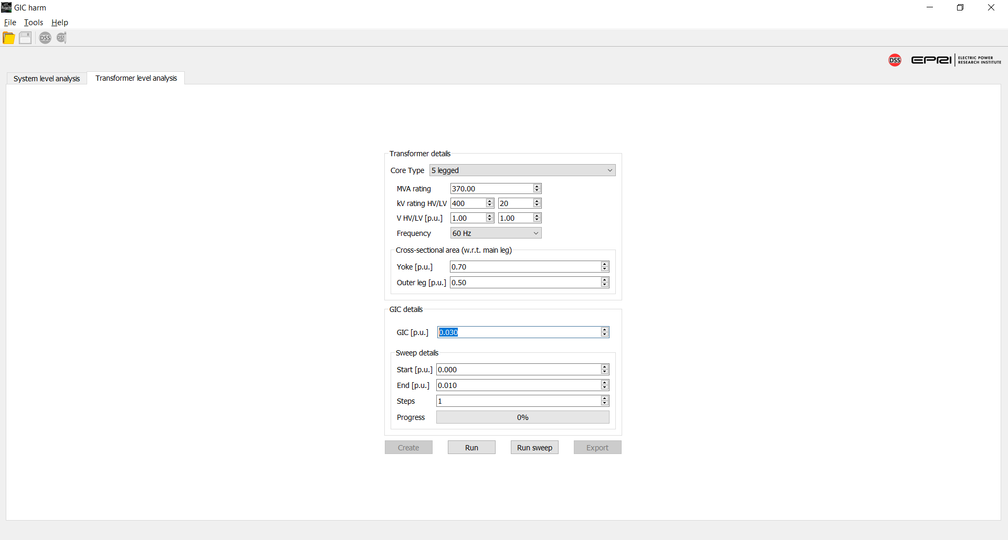
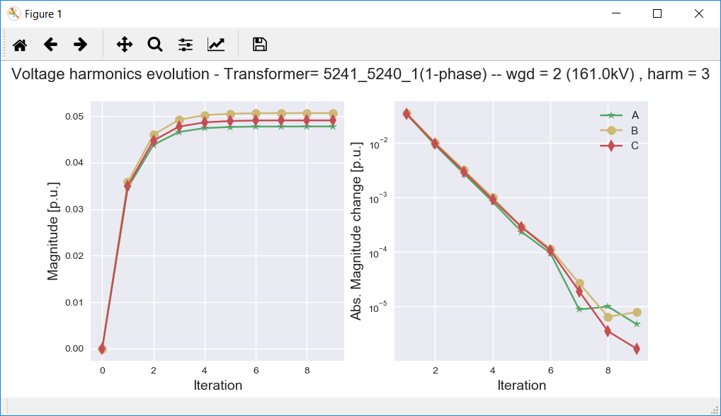
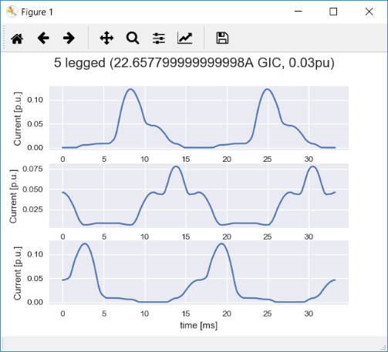
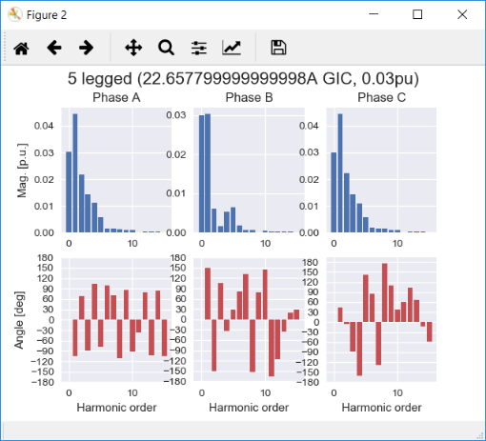
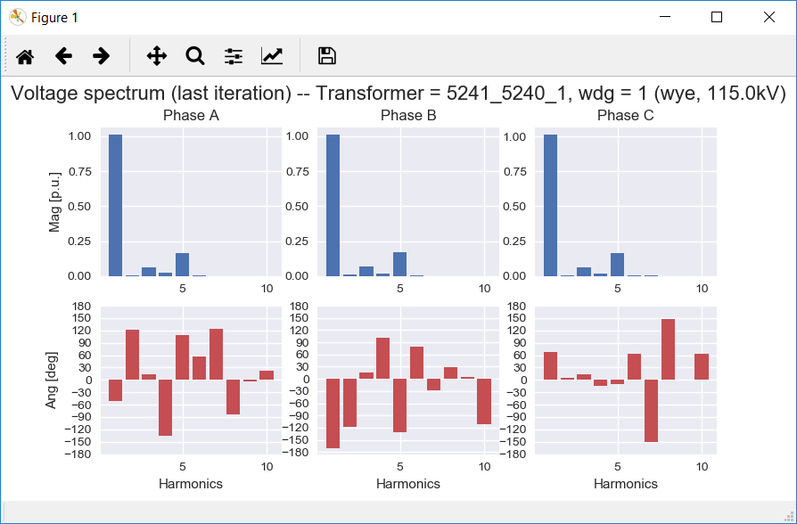
GICharm Capabilities
Transformer level analysis
System level Analysis
PSS®E to GICharm / OpenDSS converter

Slide 12
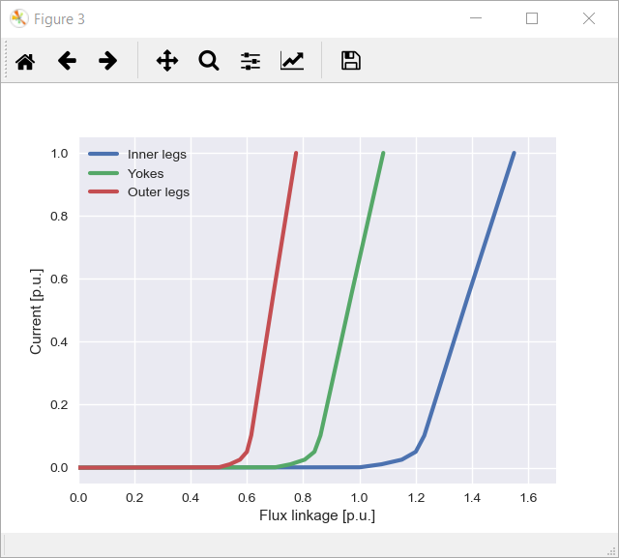
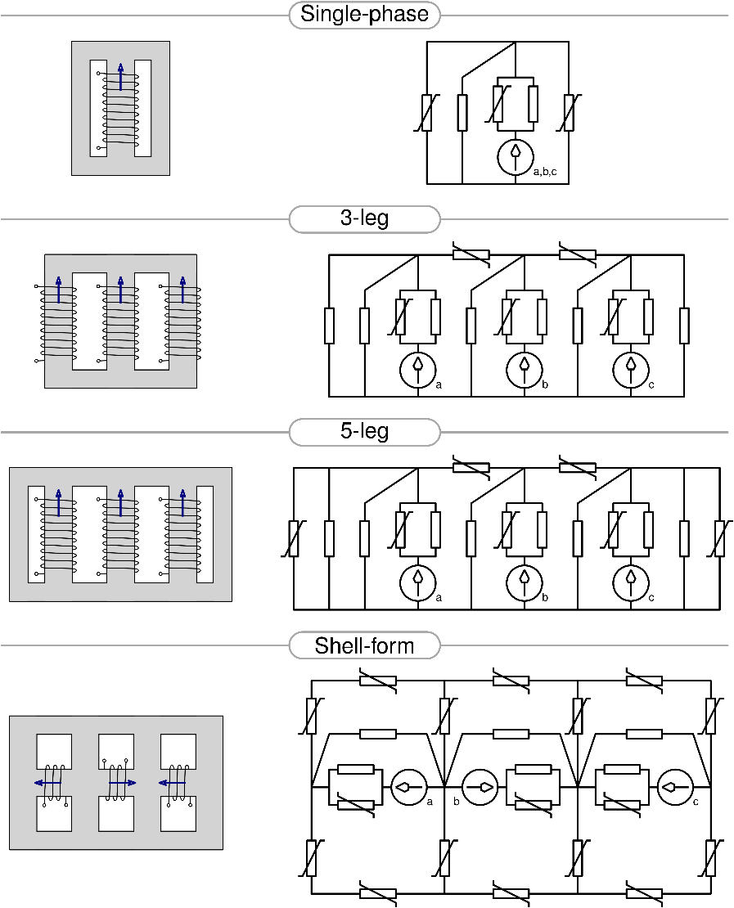
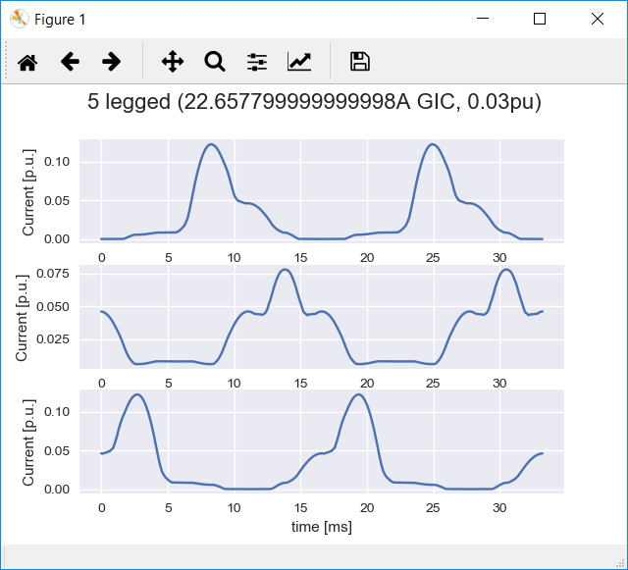

Transformer Level Analysis
Non-linear saturation analysis
Time domain analysis
Magnetic circuit modeling

Slide 13
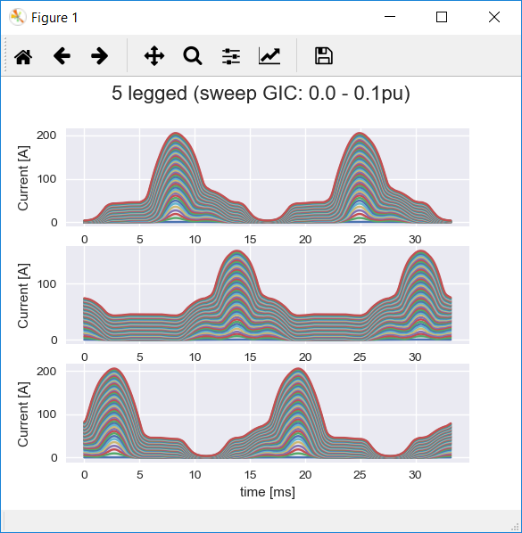
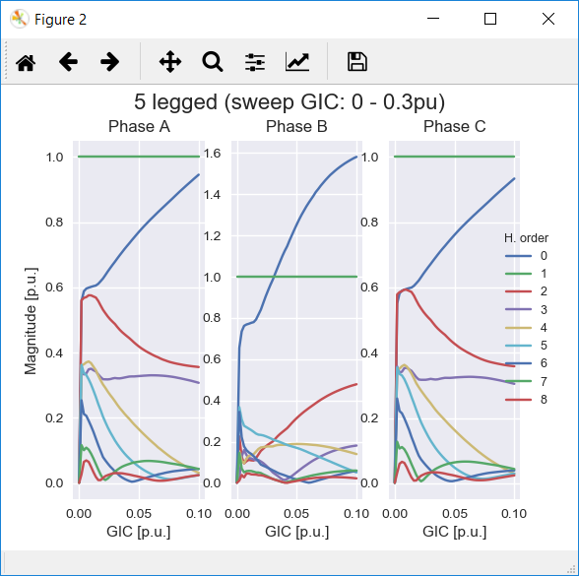
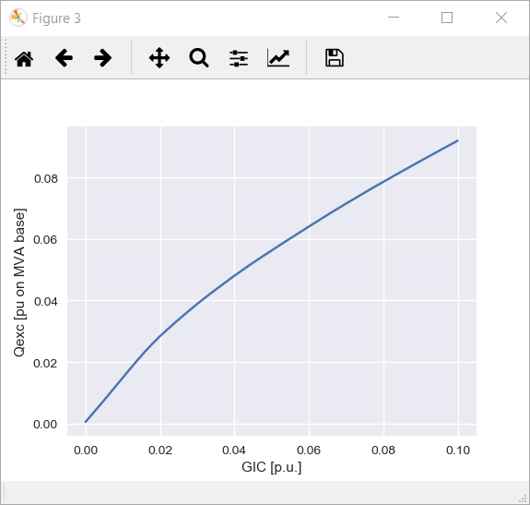
Transformer Level Analysis
Non-linear saturation analysis
Time domain analysis
Magnetic circuit modeling

Slide 14
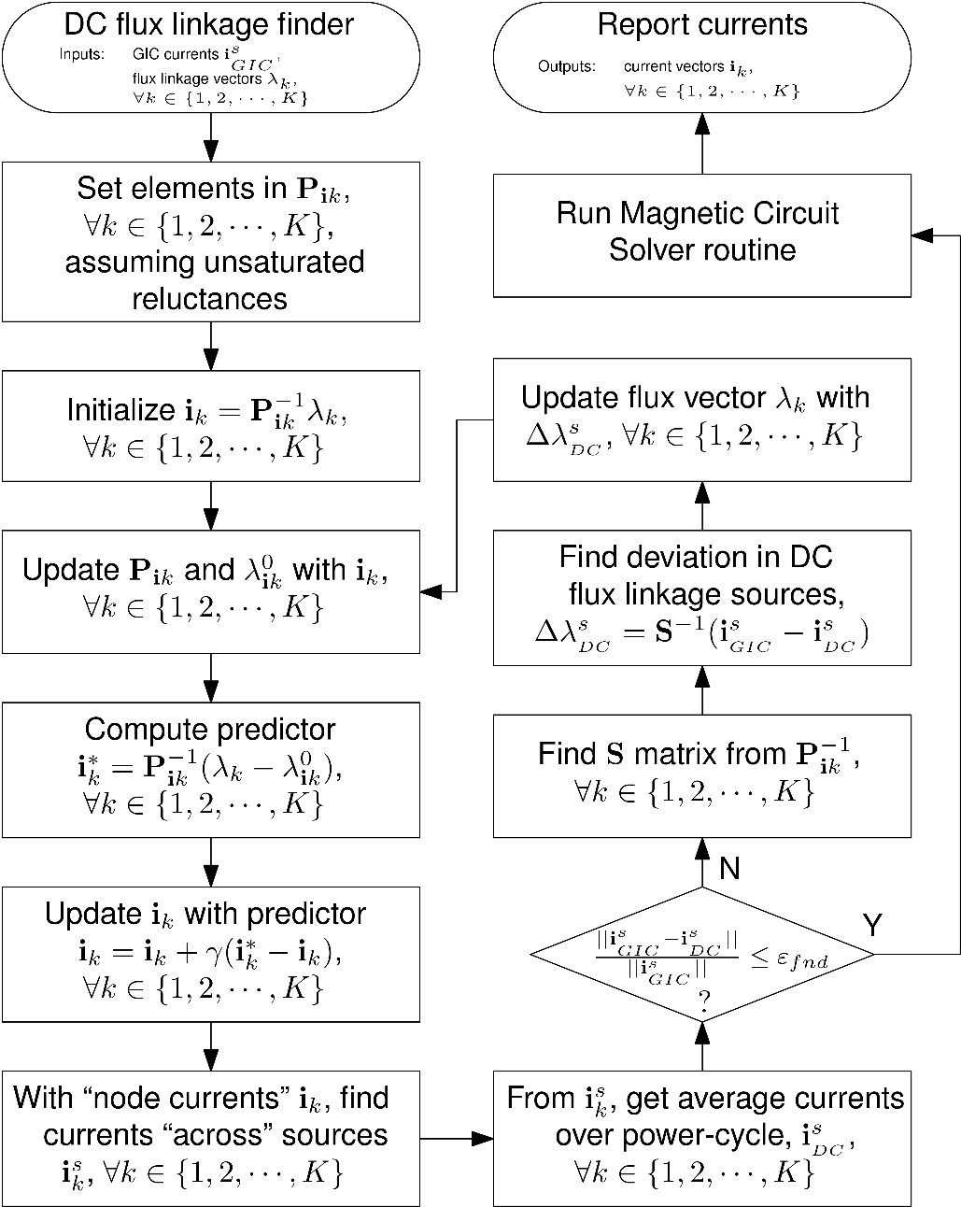
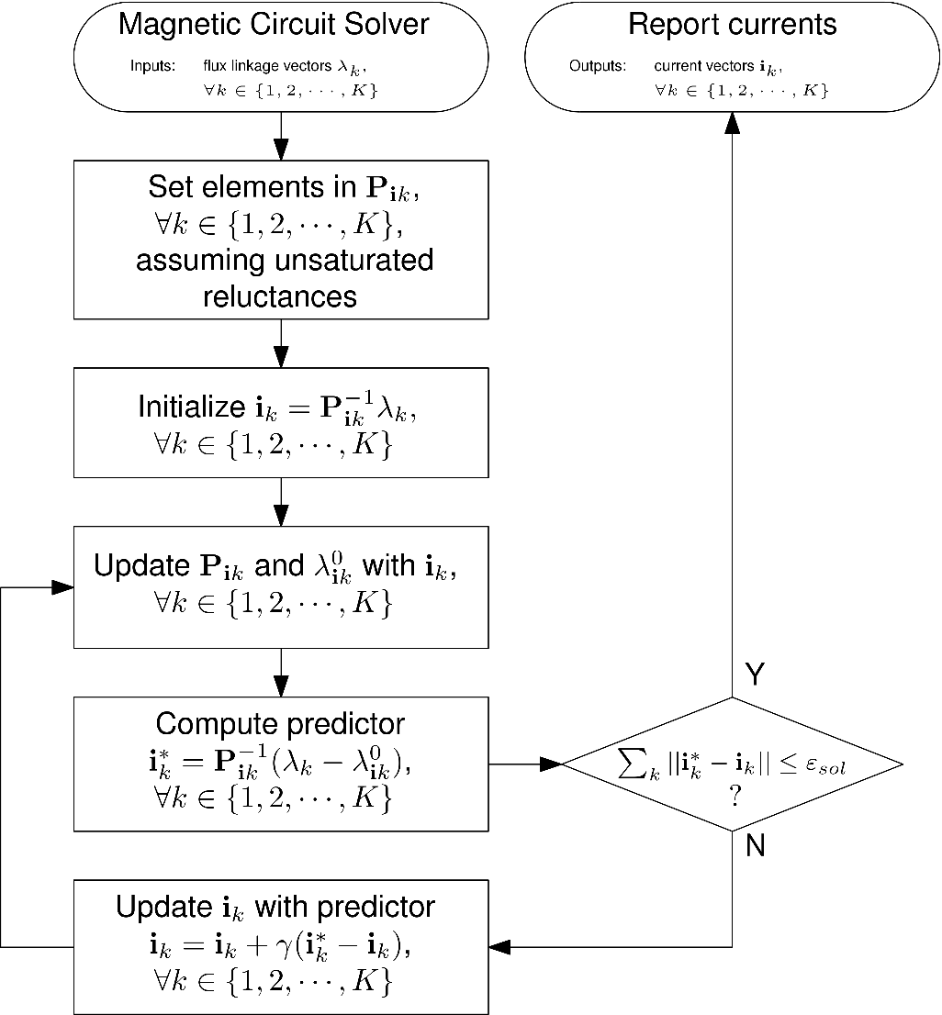
Transformer Level Analysis
Networks of nonlinear monotone reluctances
Solves for the excitation currents per time step in a power cycle
Finds flux offset over the power cycle for a given GIC input

Slide 15
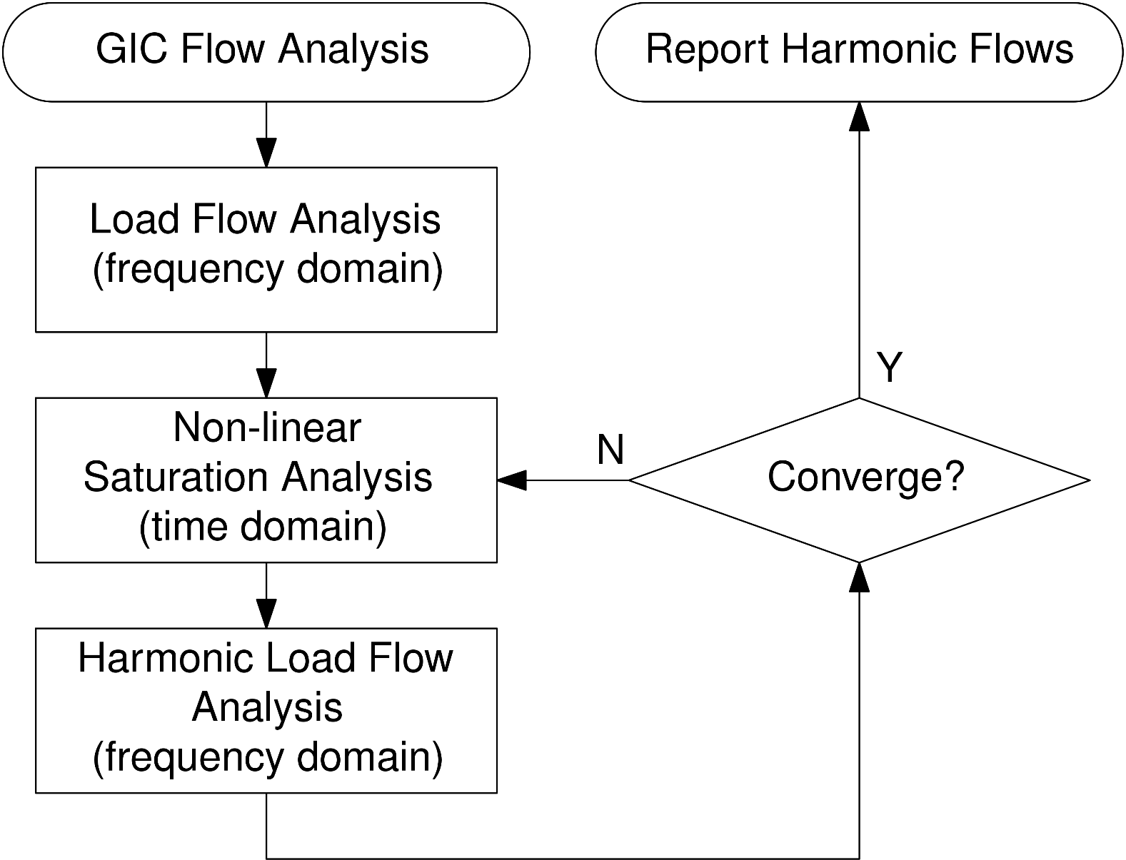
System Level Analysis
Pre-event system state is determined by a load flow. Can be determined by an external source (PSS®E)
GIC flows are determined from geo-electric field parameters

Slide 16
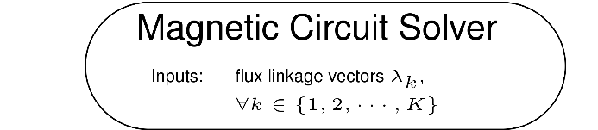
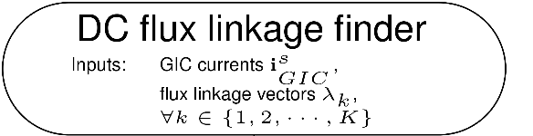
System Level Analysis
Pre-event system state is determined by a load flow. Can be determined by an external source (PSS®E)
GIC flows are determined from geo-electric field parameters
Transformer level analysis performed for each transformer in the fleet

Slide 17

System Level Analysis
Pre-event system state is determined by a load flow. Can be determined by an external source (PSS®E)
GIC flows are determined from geo-electric field parameters
Transformer level analysis performed for each transformer in the fleet
Harmonic load flow to determine voltage harmonic distortion throughout the system

Slide 18
System Level Analysis
Pre-event system state is determined by a load flow. Can be determined by an external source (PSS®E)
GIC flows are determined from geo-electric field parameters
Transformer level analysis performed for each transformer in the fleet
Harmonic load flow to determine voltage harmonic distortion throughout the system
Repeat until convergence criteria is reached

Slide 19
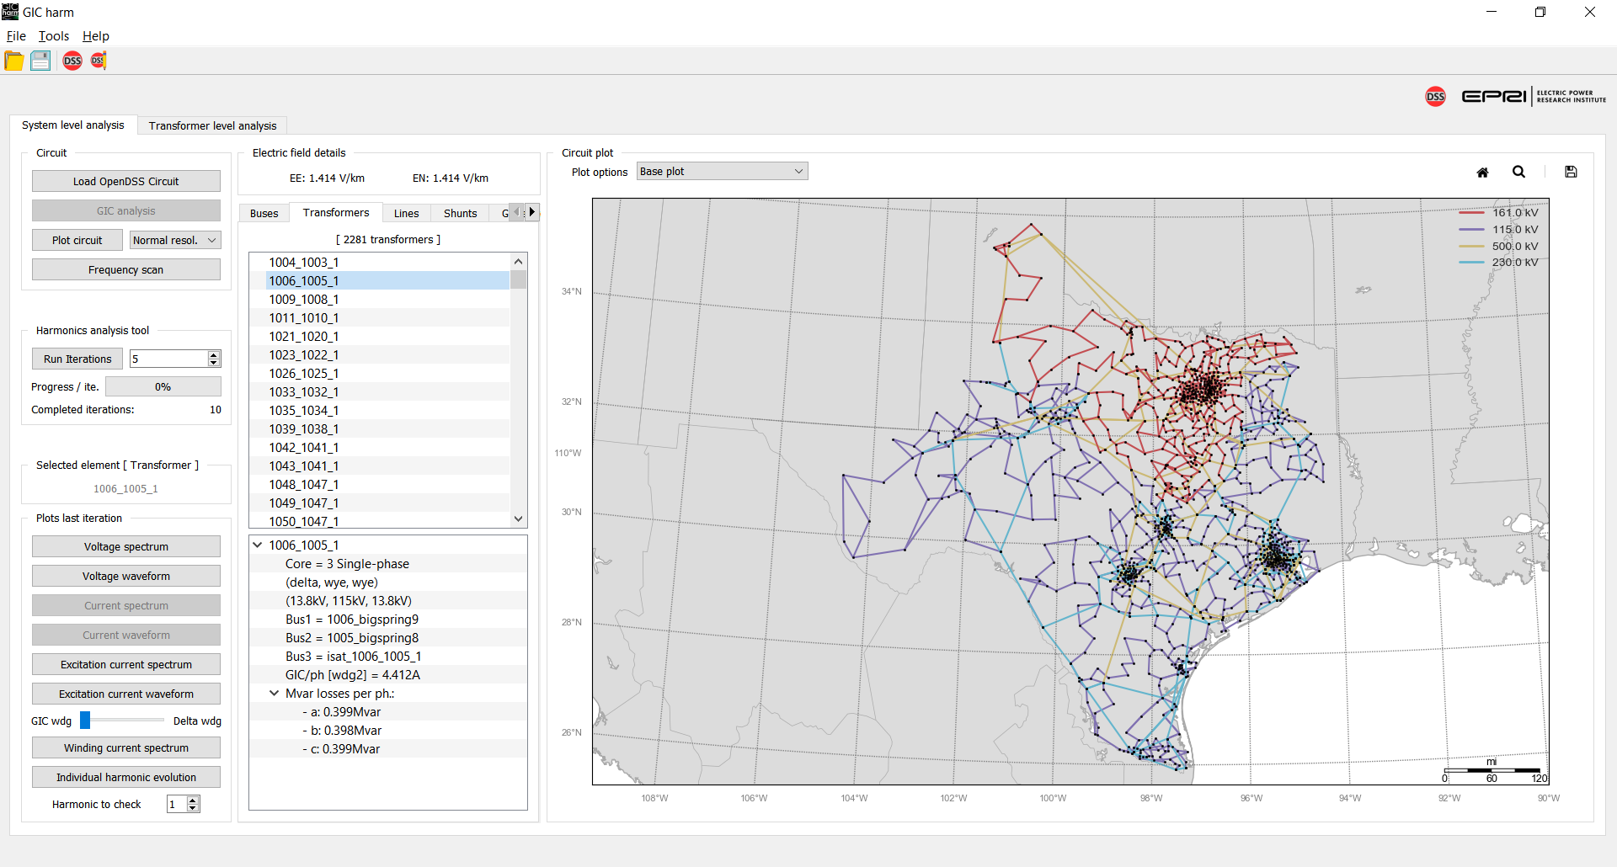
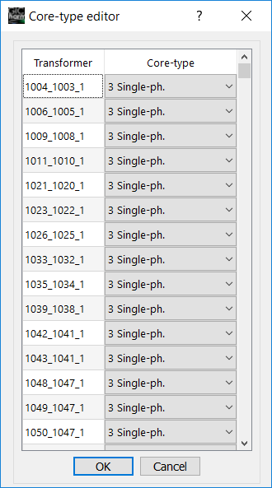
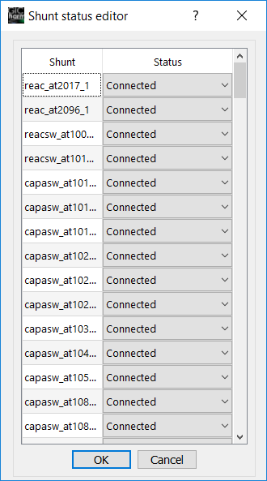
System Level Analysis – Explore System Details
Tool allows to explore relevant elements:
Buses
Transformers
Lines
Shunts
Generators
Allows the user to consider different scenarios by changing:
Transformer core topologies
Geo-electric field components
Connect / disconnect Capacitor banks

Slide 20
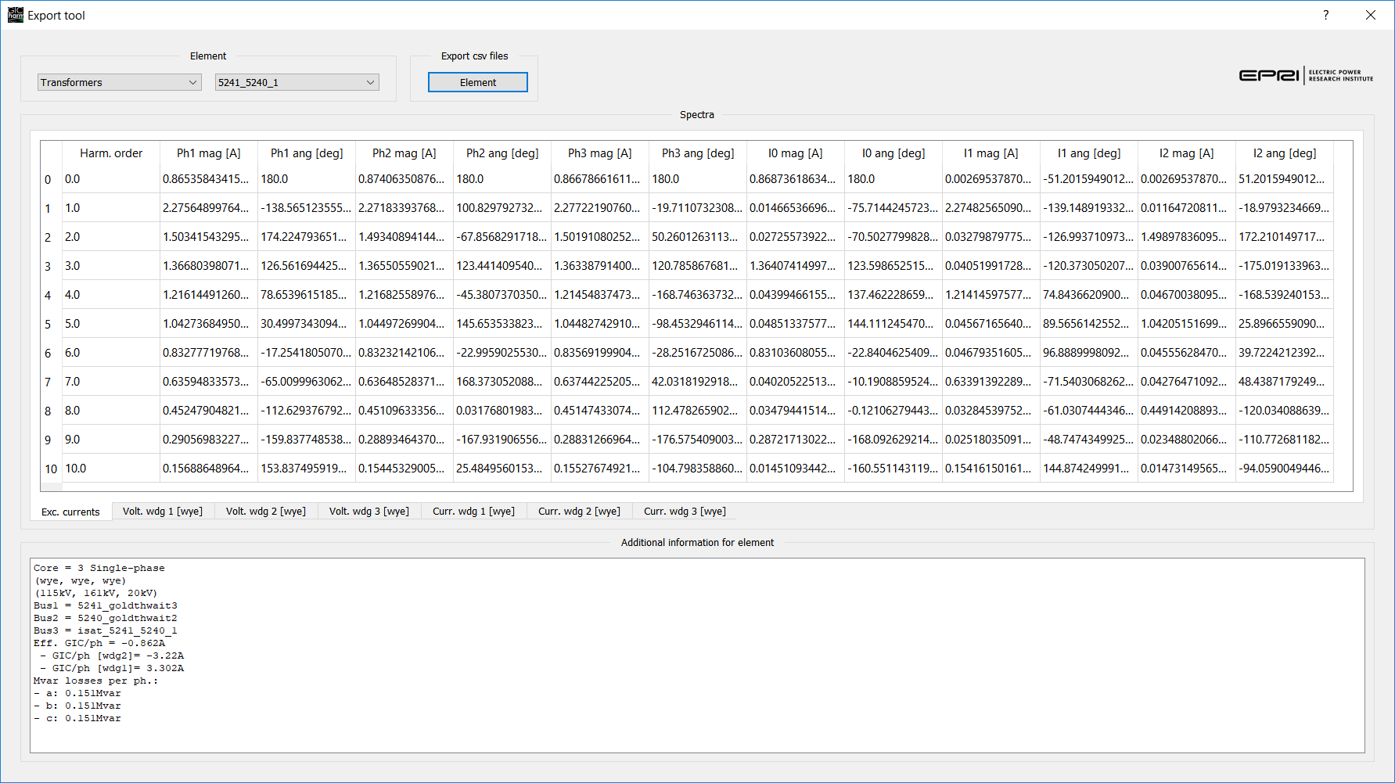
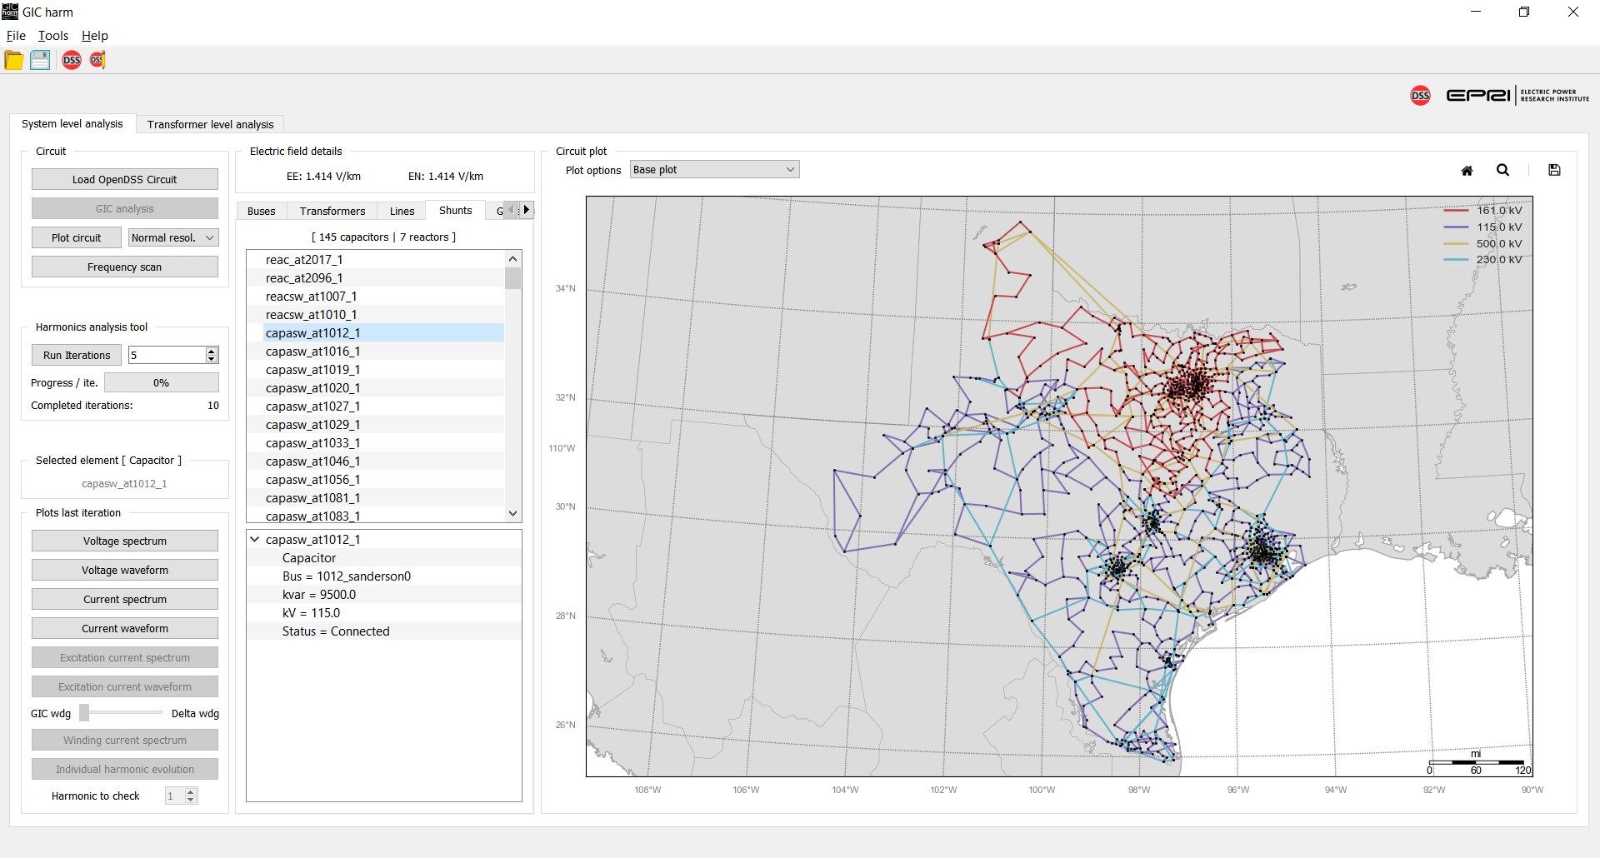
System Level Analysis – Explore Simulation Results
Explore simulation results with waveforms and spectra of voltage and current for:
Transformer windings
Capacitors and reactors
Generators
For transformers
Evolution of the harmonic content of voltage through the iterations of the harmonic loop
Export results to csv files: The tool includes a built-in tool to export user-selected results.

Slide 21
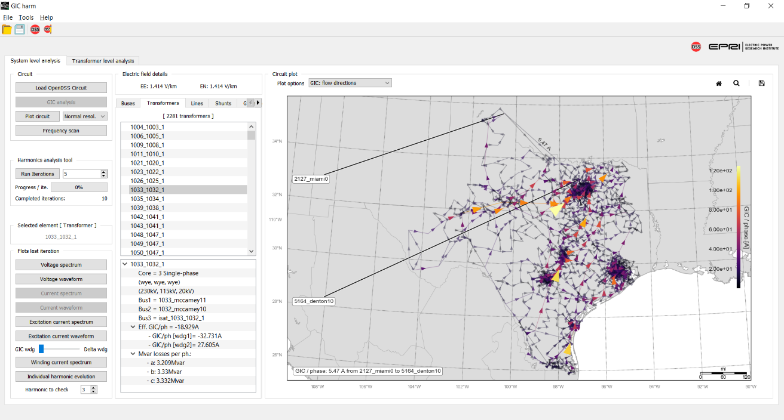
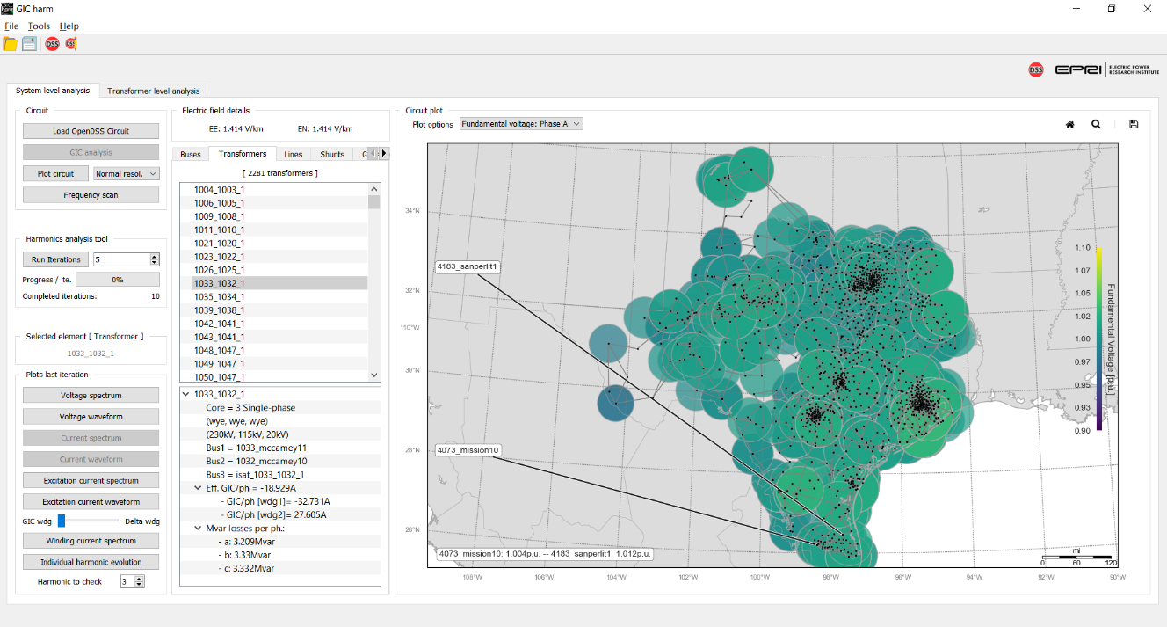
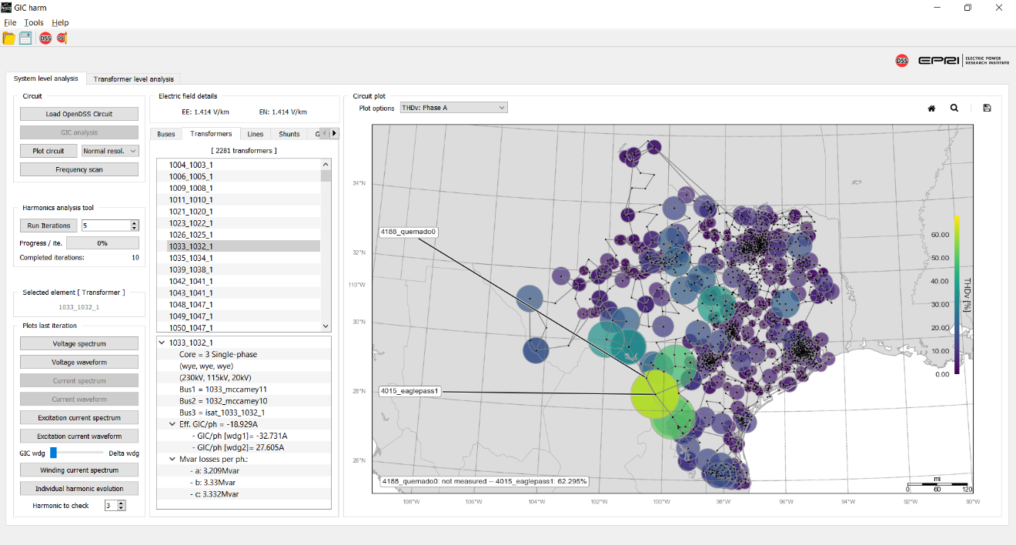
System Level Analysis – Explore Simulation Results
GUI includes circuit plot capabilities to overlay GIC flows, voltage THD and fundamental voltage data over the circuit footprint

Slide 22
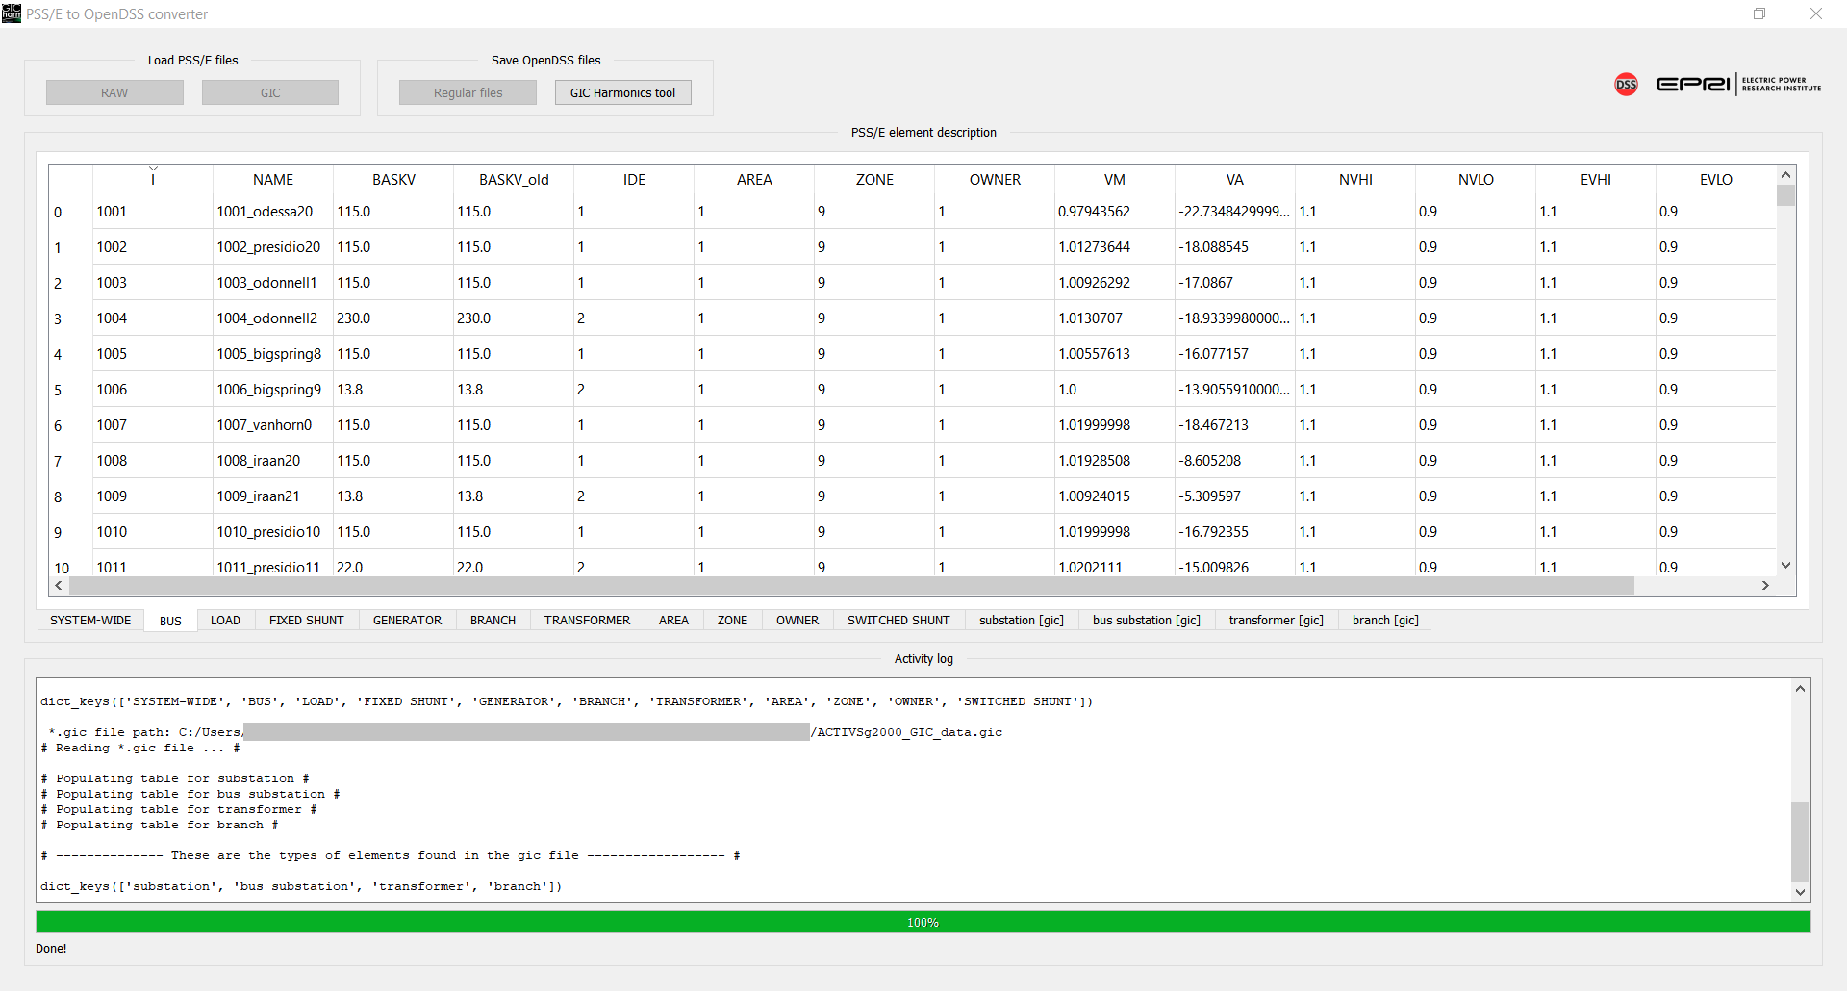
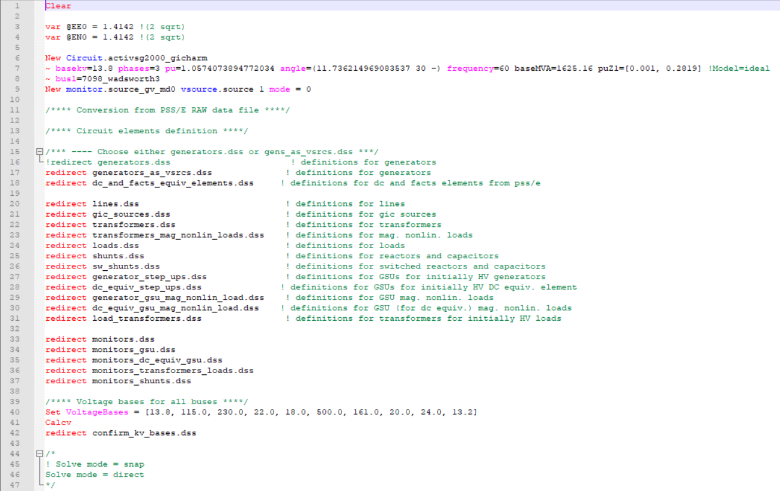
PSS®E to OpenDSS Converter
Data imported from PSS®E *.raw and *.gic files
Data cleaning after import
Data conversion to regular and GICharm *.dss files

Slide 23
Validation Case and Other Cases to Explore

Slide 24
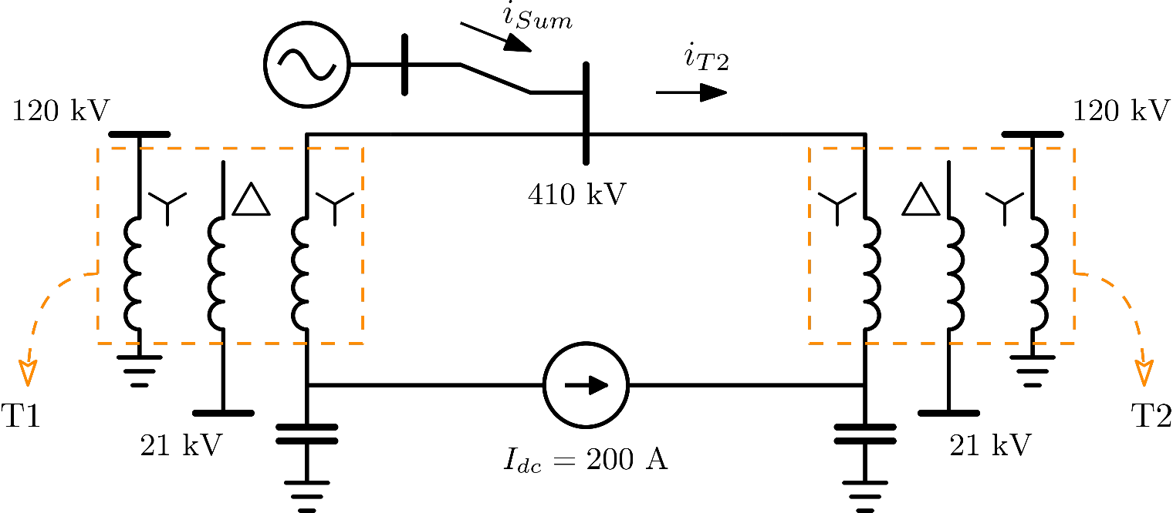
Validation Case: FinGrid Experiment
Experiment with two 5-limb core-form transformers connected back-to-back forming a loop
Neutrals of HV Wye windings connected by a DC current source to simulate a GIC event
DC source set to 200 A or 66.67A per phase
HV windings grounded by 150 uF capacitors to keep the DC currents in the loop
[4] M. Lahtinen, and J. Elovaara, “GIC Occurrences and GIC Test for 400 kV System Transformer,” IEEE Trans. Power Del., vol. 17, no. 2, pp. 555-561, 2002.

Slide 25
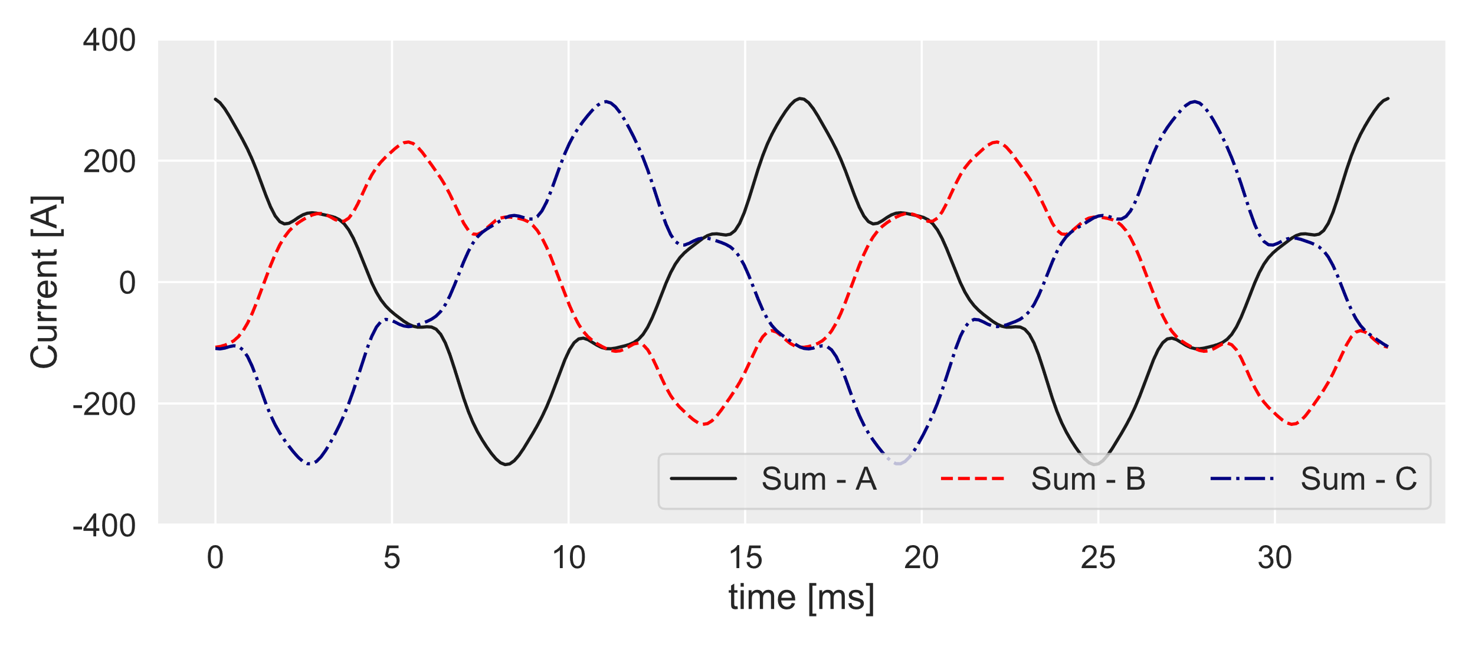
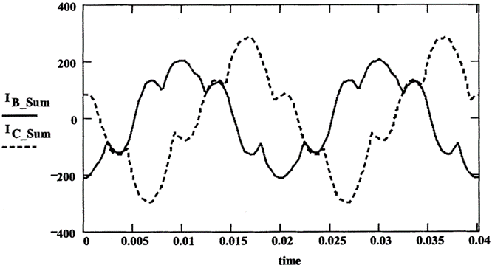
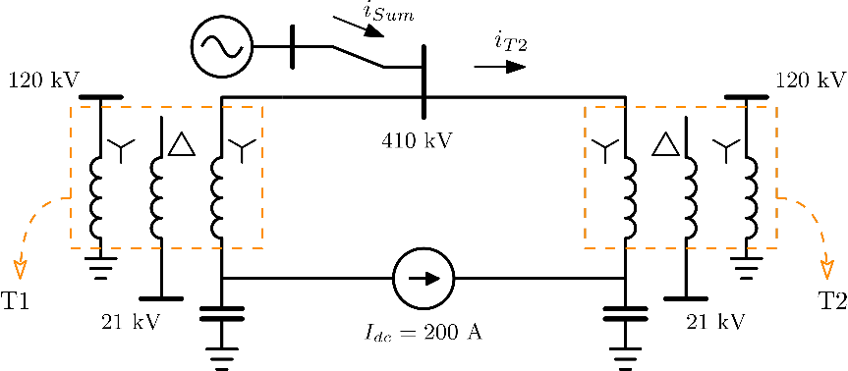
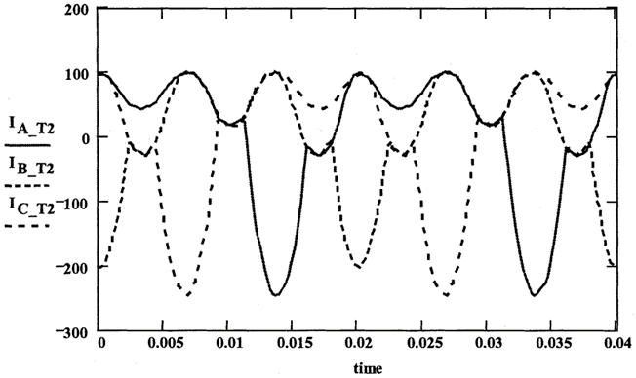
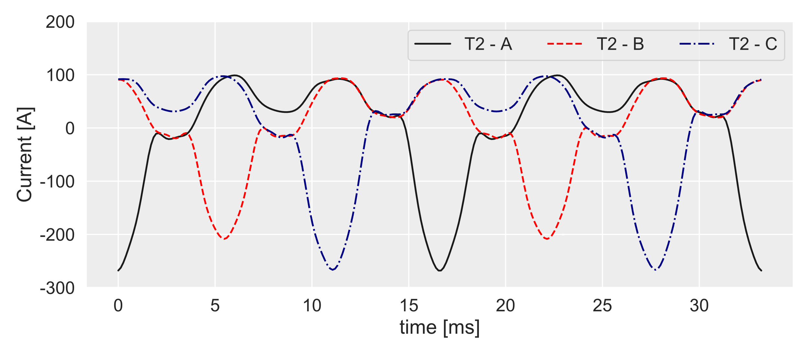
Experimental results Used with permission from IEEE [4]
Simulation Results GICharm
A. Ovalle, R. C. Dugan and R. F. Arritt, "GICharm: A System Level Analysis Tool for Geomagnetic Disturbance Related Harmonics," in IEEE Transactions on Industry Applications, vol. 58, no. 2, pp. 1406-1415, March-April 2022, doi: 10.1109/TIA.2022.3145770.

Slide 26
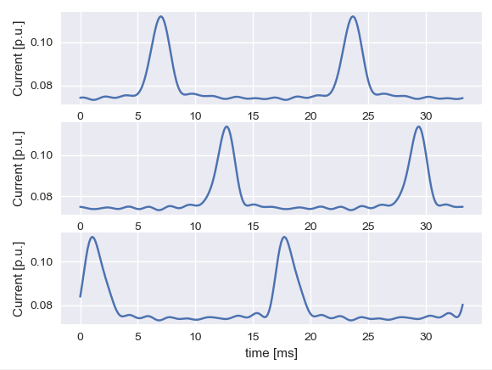
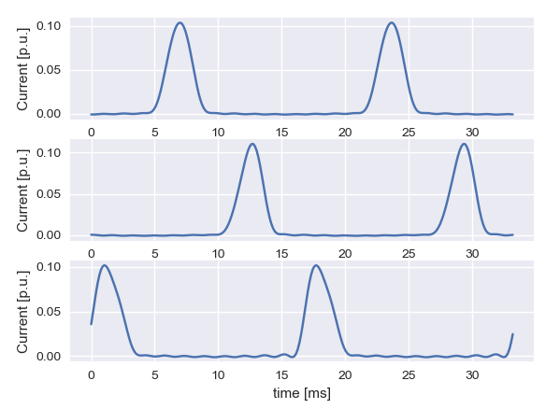
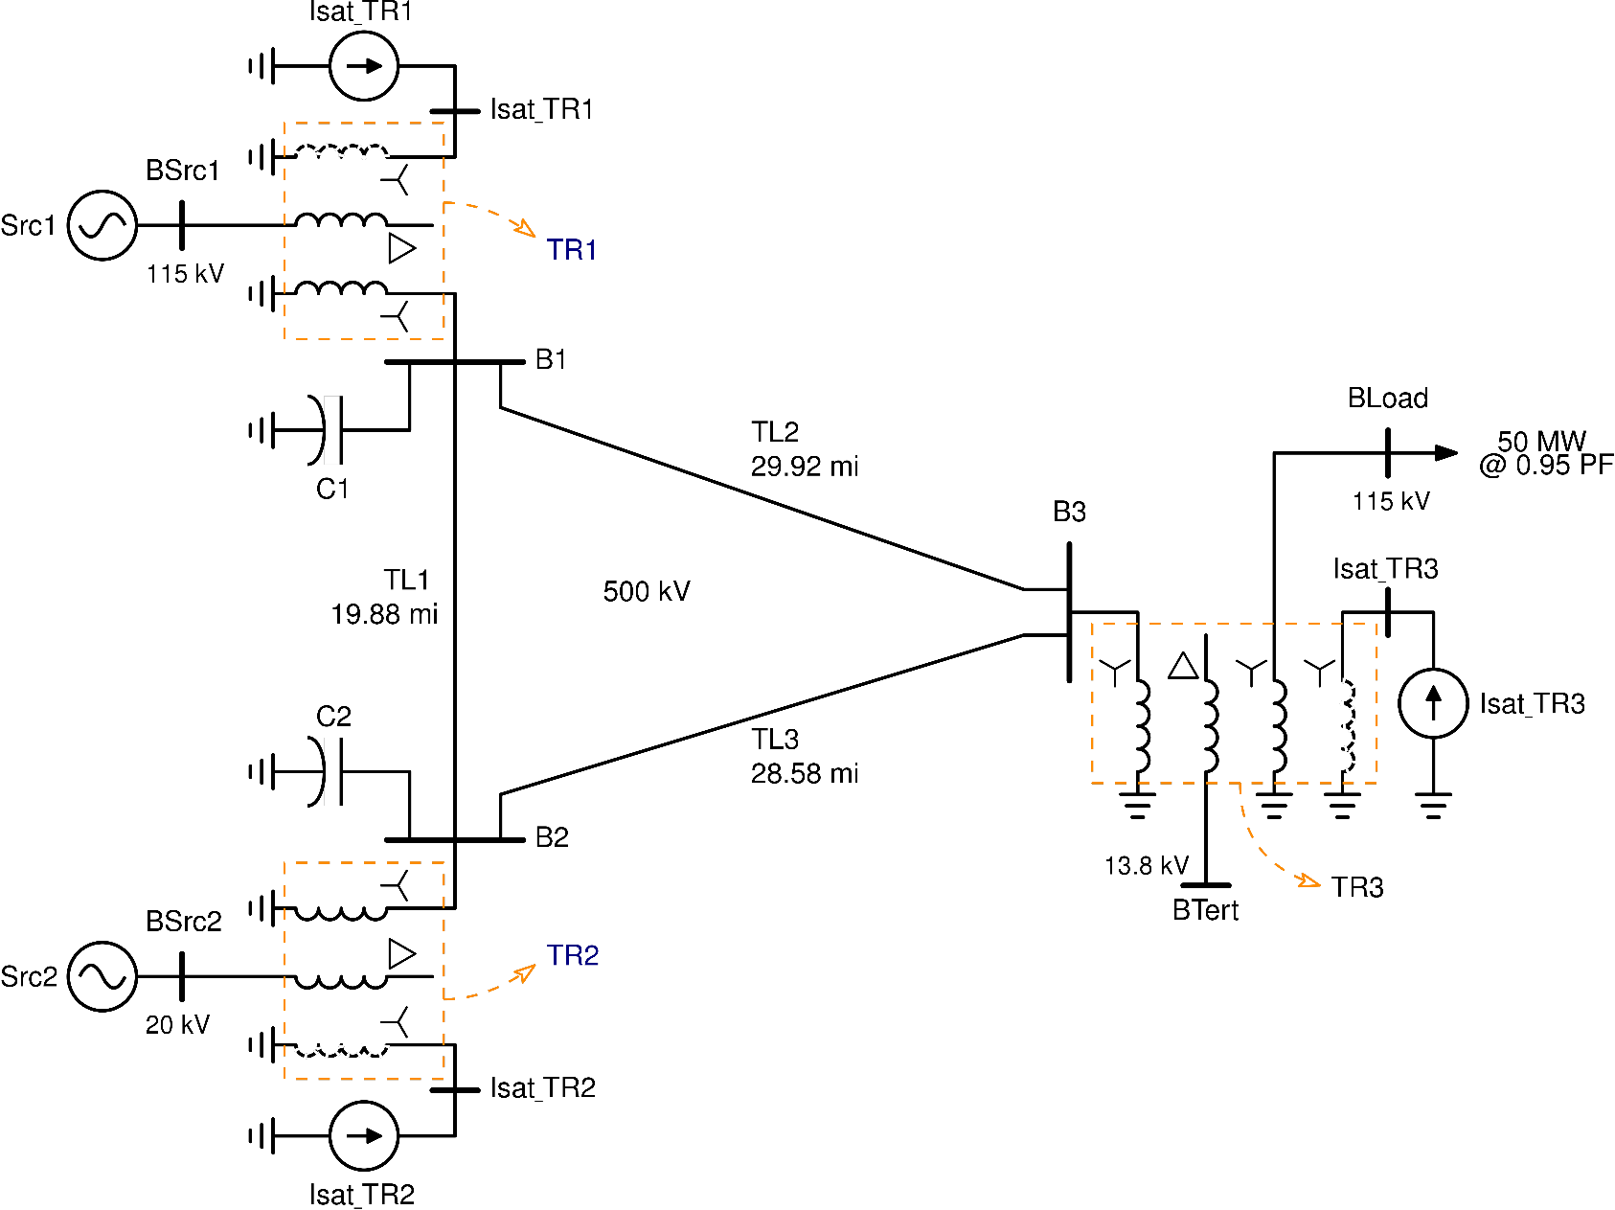
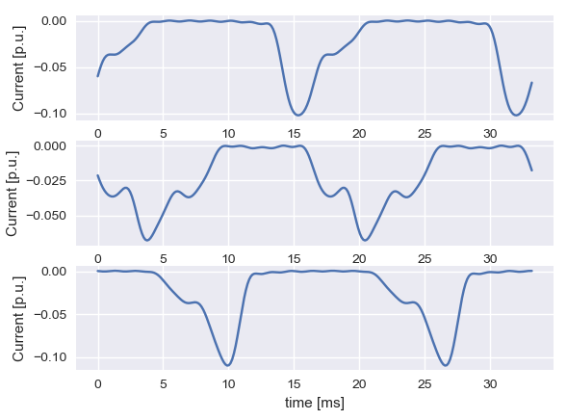
3-Bus Benchmark Case
27.8 Mvar
TR1: 22.6 A
TR2: 12.9 A
Transformer excitation currents
0.9 Mvar
TR2: -35.5 A
A: 11.7 Mvar B: 9.7 Mvar C: 12.0 Mvar
33.4 Mvar
[4] A. Ovalle, R. Dugan, and B. Arritt, “A Test Case for GIC Harmonics Analysis,” in CIGRE US National Committee 2019 Grid of the Future Symposium, 2019.

Slide 27
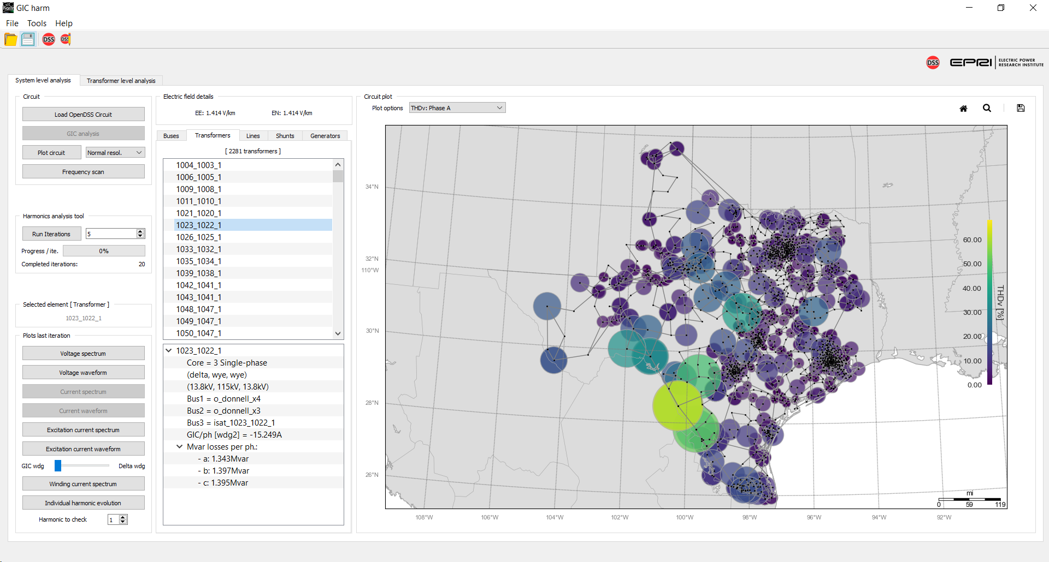
Other Test Cases to Explore
ERCOT synthetic case from Texas A&M University - Electric Grid Test Case Repository.
2k buses
861 Transformers
2,281 Transformers including added load transformers and GSUs
[5] A. B. Birchfield, T. Xu, and T. J. Overbye, “Power flow convergence and reactive power planning in the creation of large synthetic grids,” in IEEE Transactions on Power Systems, 2018.

Slide 28
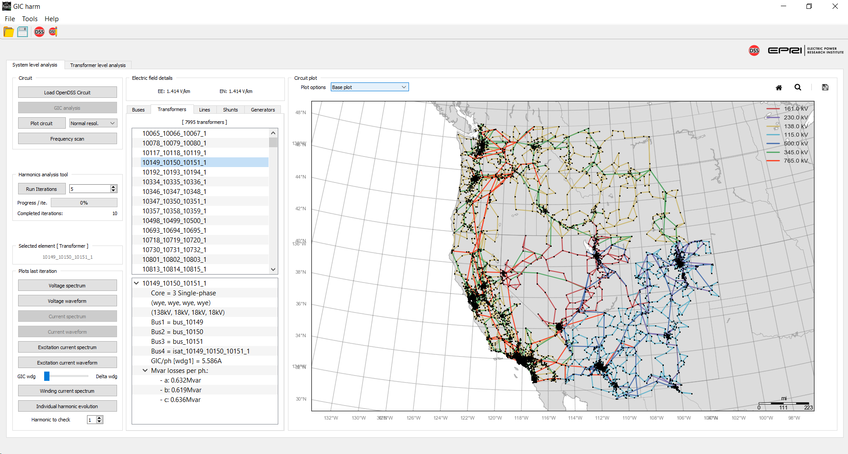
Other Test Cases to Explore
Western Interconnect synthetic case from Texas A&M University - Electric Grid Test Case Repository
10k buses
2,380 Transformers
7,995 Transformers including added load transformers and GSUs
[5] A. B. Birchfield, T. Xu, and T. J. Overbye, “Power flow convergence and reactive power planning in the creation of large synthetic grids,” in IEEE Transactions on Power Systems, 2018.

Slide 29
Thank you! Questions?

